Slide 1
Hanslope Primary School Multiplication Tables Check Meeting for parents
Tuesday 4th February 2020

Slide 2
What is the purpose of the Multiplication Tables check?
To determine whether year 4 pupils can fluently recall their multiplication tables.
It is crucial to be fluent in tables to make learning in later years easier.
To help schools to identify pupils who require additional support.
There is no ‘pass’ rate or threshold.
The DfE will create a report on overall results across all schools
in England to measure improvements.

Slide 3
When the Multiplication Tables Check will be carried out
There will be 3-week window in June for the administration of the check; the school will decide when to administer the check within the 3-week window.
Children are not expected to take the check at the same time; they will take the check in small groups.
All eligible* year 4 pupils England will be required to take the check.
*If a pupil is not entered for the check, the school will inform the pupil’s parents.

Slide 4
How the Multiplication Tables Check is carried out
The check is fully digital and takes place on screen.
Children will be able to use ipads.
Answers will be entered using an on-screen number pad.

Slide 5
How the Multiplication Tables Check is carried out
Under standard administration the multiplication check will take less than 5 minutes per pupil.
Children will get 6 seconds from the time the question appears to input their answer.
There will be 25 questions with a 3 second pause in-between questions.

Slide 6
What will the questions be like?
Each pupil will be randomly assigned a set of questions.
There will be repeated questions across different checks each year, but no more than 30% of questions will be repeated in any two checks.
Children will only face multiplication statements in the check (not related division facts).
Pupils will not see their individual results when they complete the
check but the school will be advised about each pupil’s individual score
once the Multiplication Check window has closed.

Slide 7
What will the questions be like?
There will always be questions from the 3, 4, 5, 6, 7, 8, 9, 11 and 12 multiplication tables in each check.
There will be no questions from the 1 times table (i.e 1 x 8 or 8 x 1).
Questions from the 6, 7, 8, 9 and 12 times tables are more likely.
There will only be a maximum of 7 questions from the 2, 5 and 10 times tables.
Reversal of questions will not feature in the same check.

Slide 8
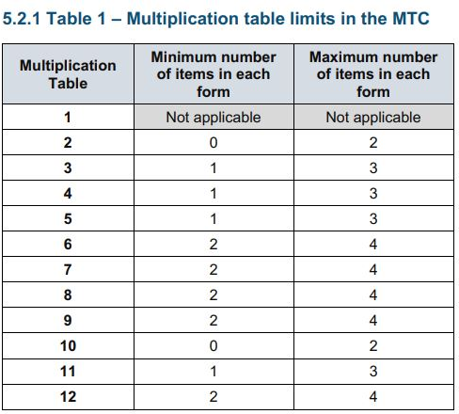
What will the questions be like?
The STA state that they are classifying the multiplication tables by the first number in the question. For example, 8 x 3 would fall within the 8 times table.

Slide 9
What are the most likely questions?
The following 11 multiplication questions are likely to be asked:
6 x 6, 6 x 7, 6 x 8, 6 x 9, 6 x 12
7 x 8, 7 x 9, 7 x 12
8 x 9, 8 x 12
12 x 12

Slide 10
Can children practise?
There is a ‘try it out’ area that children can use to get used to the timings and practise typing in answers on the ipad.
The ‘try it out’ area can only be accessed in school; all children will require a unique user name and password which will be issued on the day to the school.
Class teachers will ensure children get plenty of practice and so they understand what is being asked of them.

Slide 11
Example Multiplication Check that can be used at home
You can use this free multiplication table check which will give you an idea of the speed at which children will be asked questions:
https://mathsframe.co.uk/en/resources/resource/477/Multiplication-Tables-Check
TTRockstars also helps children’s speed

Slide 12
Other ways to support at home
Practise answering quick fire times table questions where children only have 6 seconds to answer.
Make links by using known facts e.g. 5x 9 = 45 so 9 x 5 = 45 – by using facts from ‘easier tables’ children can become more confident.
Make links between tables e.g. 3 and 6, 4 and 8.
Continue to learn related division facts e.g. 3 x 6 = 18 so 18 ÷ 3 = 6 even though these won’t be tested.
Use Times Tables Rockstars and other online games to make learning fun – see our website for ideas of other games.
Go outside – chalk tables, racing tables and loads of other games

Slide 13
Any questions when you get home?
Feel free to contact…
Mrs Broughton (Maths lead)
Jenny.broughton@Hanslope.Milton-Keynes.sch.uk
Or Mrs Capp (Deputy Head)
Amanda.capp@Hanslope.Milton-Keynes.sch.uk
Or your class teacher

